Slide 1
Where to open a new fast food restaurant in Toronto?
Coursera Capstone Project

Slide 2
Introduction
I will be examining which boroughs are the best to open a new fast food restaurant in Toronto. I assume that areas with the lowest amount of (fast food) restaurants would be the best ones. This project might be interesting for anyone planning to open a new fast food restaurant, whether it’s a chain (e. g. KFC) or a small business.

Slide 3
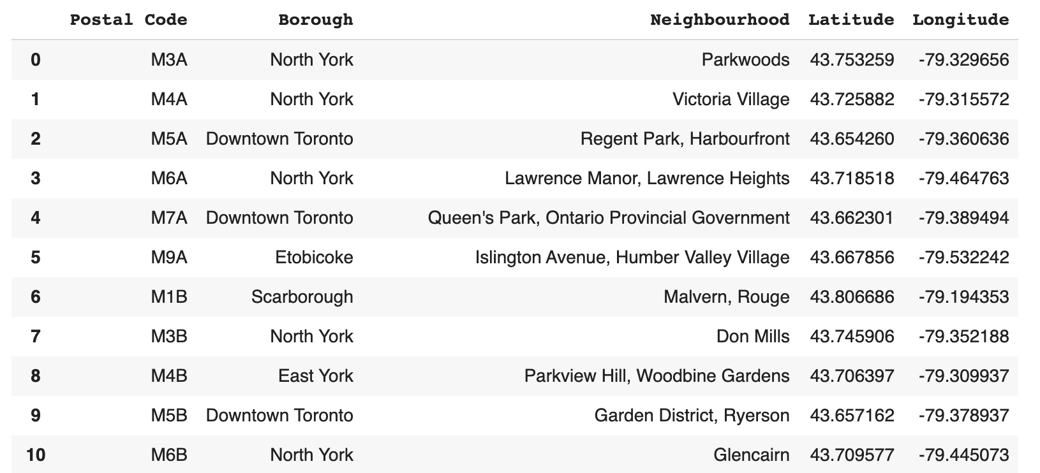
Data frame with geospatial data of Toronto

Slide 4
Methodology
I will start by creating a data frame containing a list of all boroughs and neighborhoods in Toronto, including their postal codes, latitude, and longitude. Then I will examine the number of fast food restaurants in each neighborhood using the Foursquare API. Using one hot encoding, I will generate a data frame that contains all neighborhoods and the number of venues located in them, according to the Foursquare venues categories. I will later drop all columns with neighborhoods who already have some fast food restaurants (around half of all Toronto neighborhoods). By visualizing the neighborhoods without fast food restaurants on a map, it becomes apparent that most of these neighborhoods are scattered around downtown Toronto. Using the Foursquare API again, I will generate a list of all restaurants located in the city center. By visualizing these restaurants on a map, I can see that most of them are centered around the same spot, while there are no restaurants in other parts of the Toronto city center. I suggest these parts of Toronto as an ideal location for a new fast food restaurant.

Slide 5
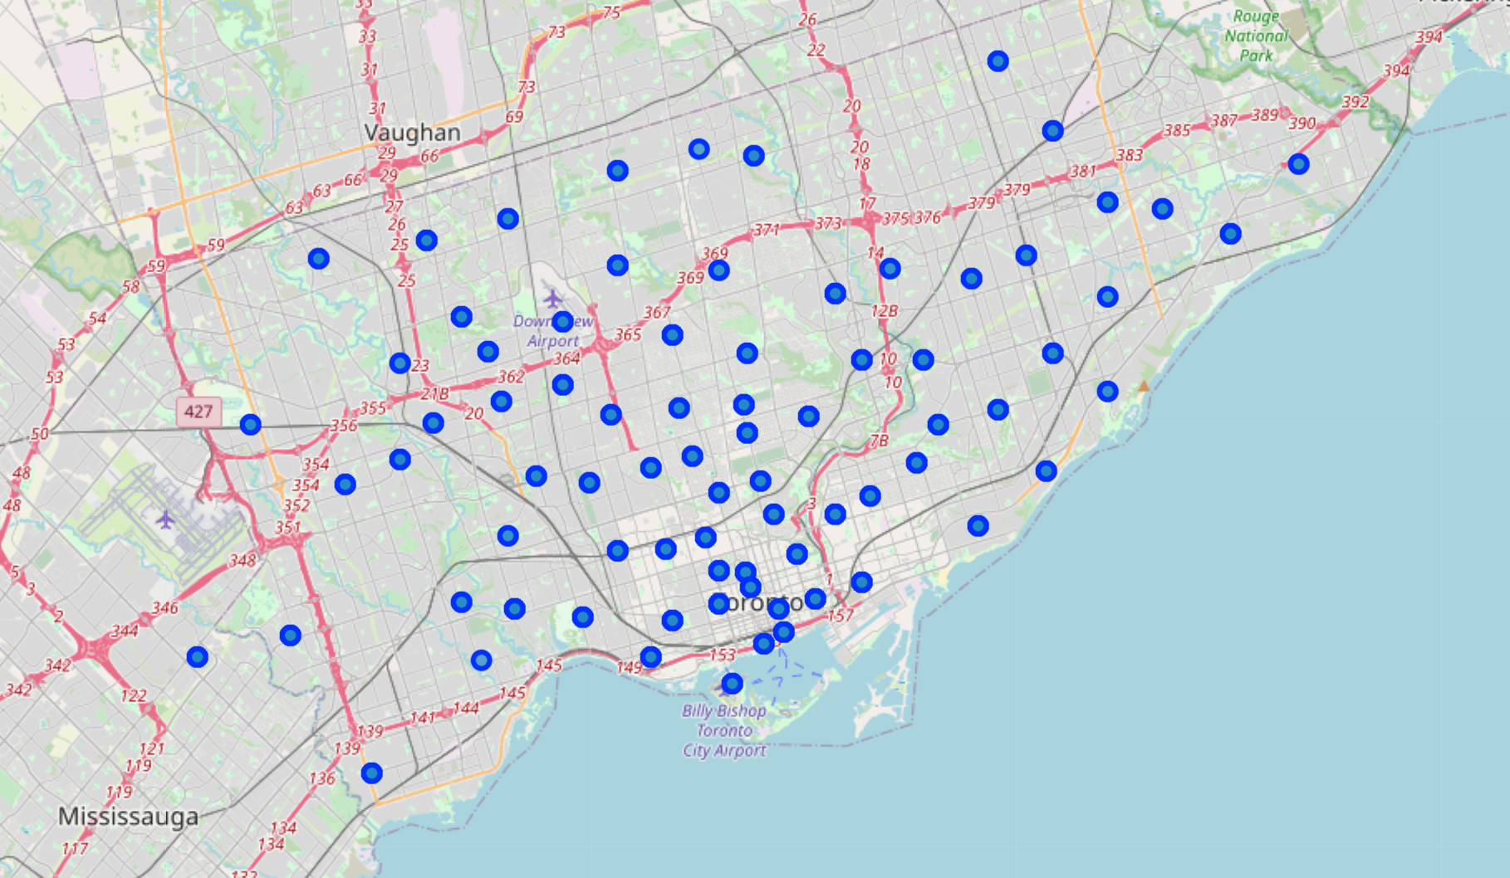
Map of neighborhoods with no fast food restaurants

Slide 6
Results
Using the methods outlined earlier, I suggest that the best place to open a new fast food restaurant in Toronto is in the city center around University-Rosedale, as there are no other restaurants in the area and no fast food restaurants even in the surrounding neighborhoods.

Slide 7
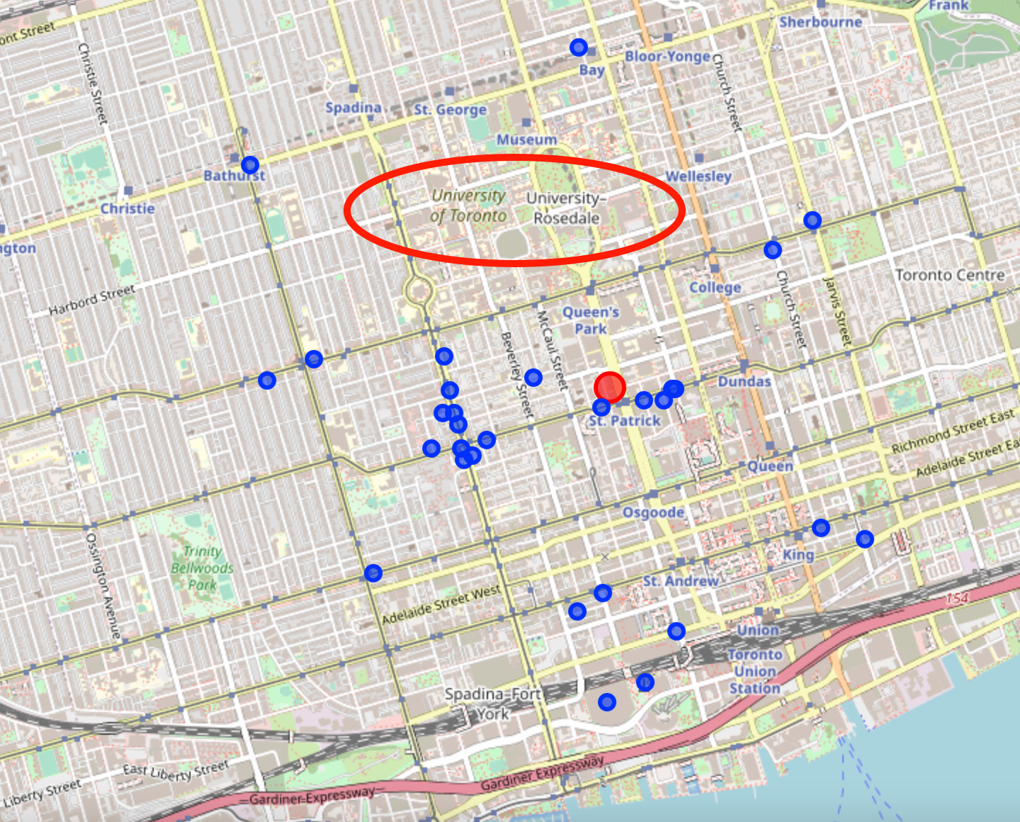
Restaurants in downtown Toronto, with an empty spot at University-Rosedale

Slide 8
Discussion
I noted that neighborhoods without any fast food restaurants are scattered all over Toronto, however, most of them are clustered around the city center, meaning that it is hard to find a fast food restaurant directly in the hearth of Toronto. In the area around University-Rosedale, there are even no restaurants at all, and I would therefore suggest opening a new fast food restaurant there, as it might easily get the attention of university students, tourists, and office employees.

Slide 9
Conclusion
This project’s goal was to find out what is the best area in Toronto to open a new fast food restaurant. Based on my data analysis, I suggest that the best place is around University-Rosedale (close to the Queen’s Park and Ontario Provincial Parliament).

